Slide 1
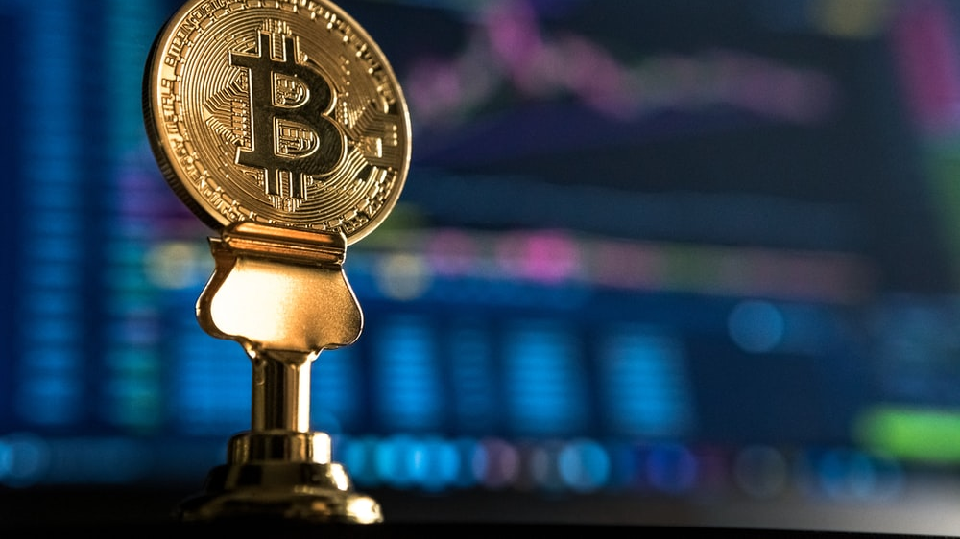

PROJECT 3:
Bitcoin genie 9000
Group 4
Greg buiter
Chrishan de almeida

Slide 2
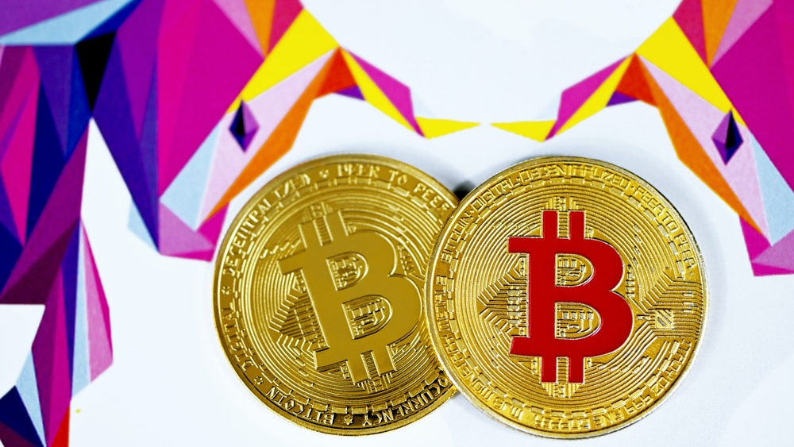
background
Bitcoin is fast becoming a must-have asset in everyone’s investment portfolios.

Slide 3
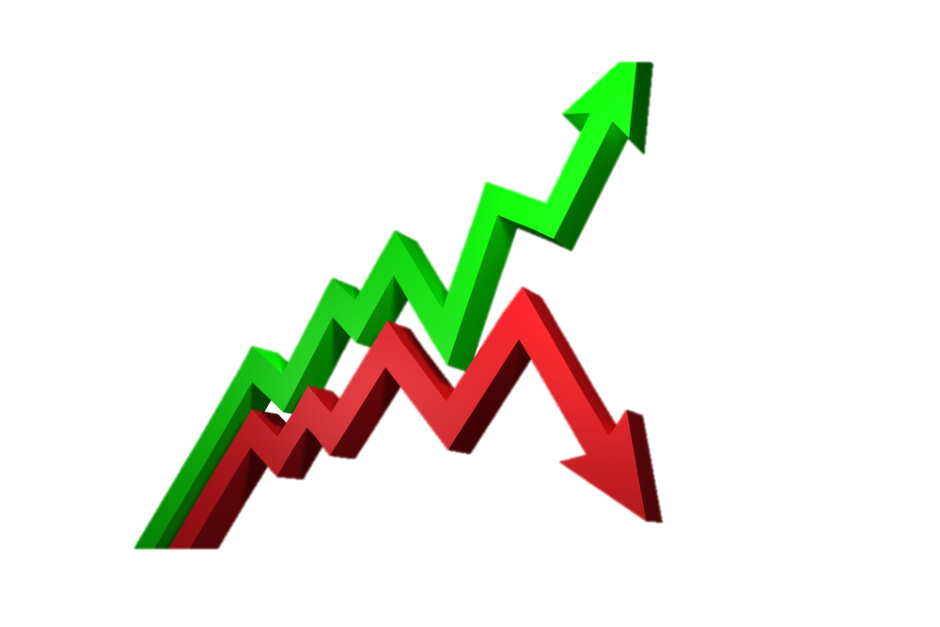




background
Buy?
Sell?!
HODL?!?

Slide 4

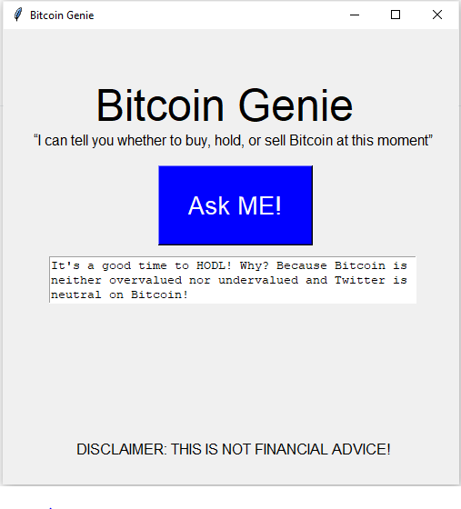
background
Previous
Our Solution…
Bitcoin genie

Slide 5
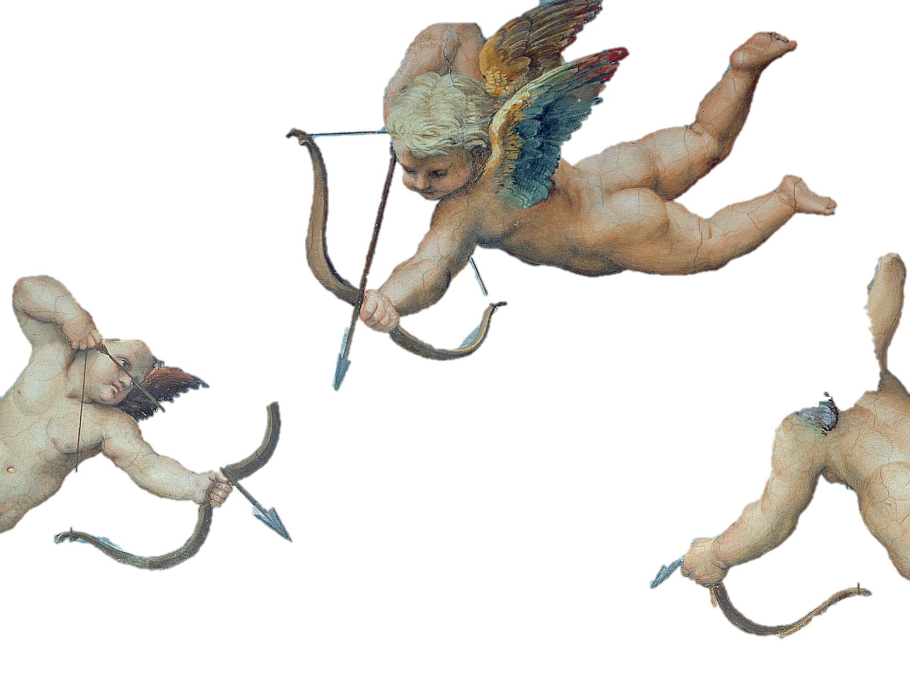
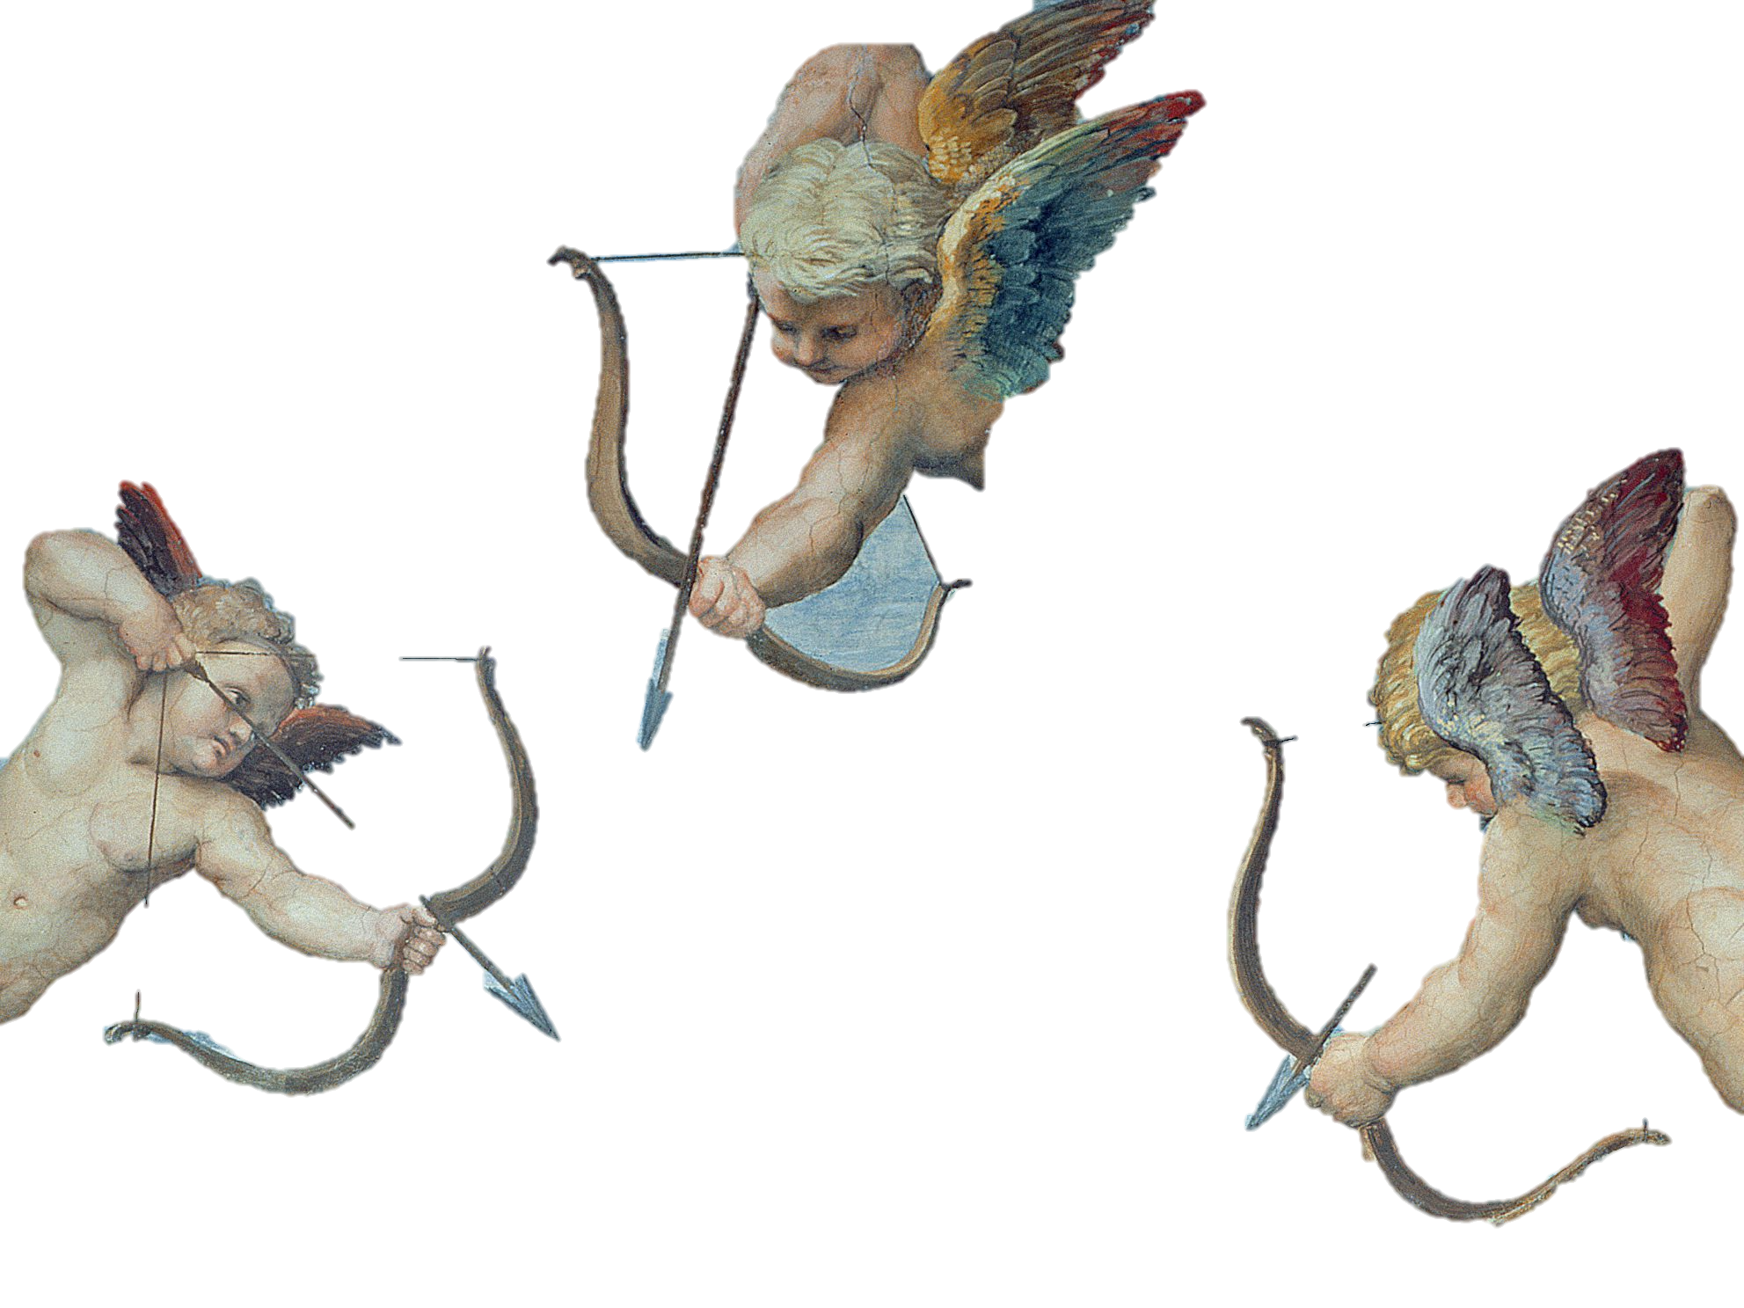
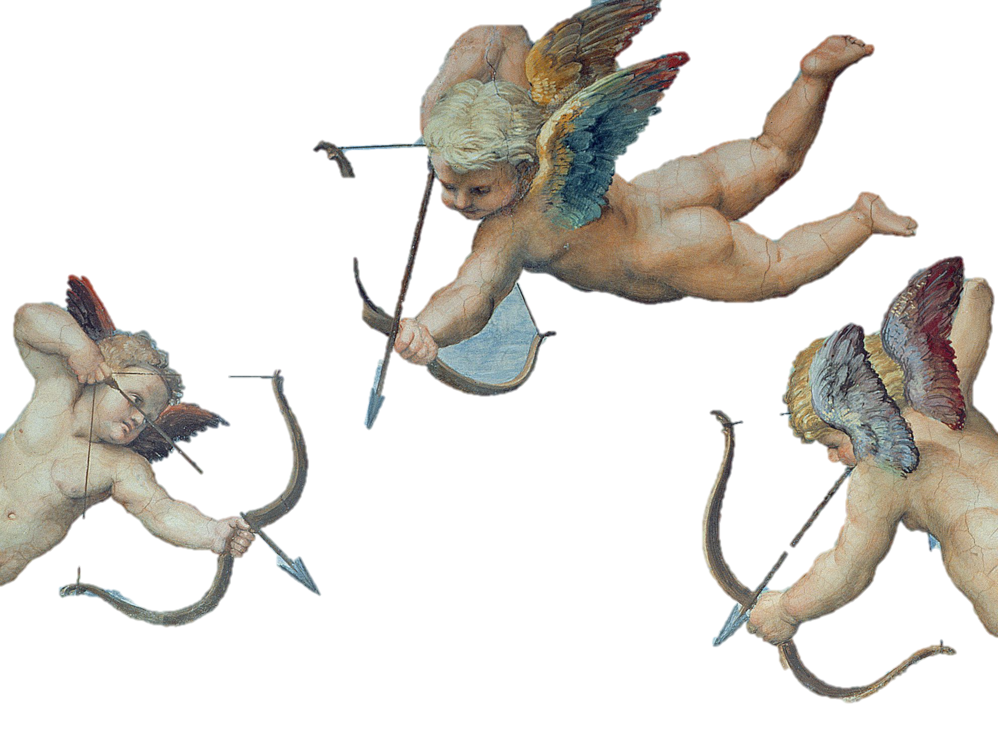
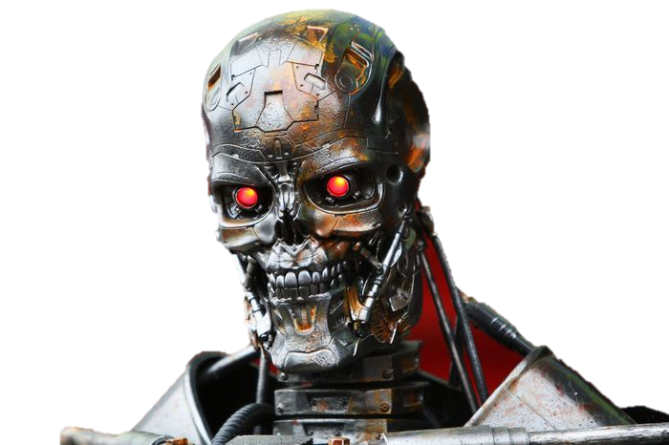
background
Our Solution…
Bitcoin genie
9000

Slide 6

Bg-9000 OFFERS…
Algorithmic Bitcoin Trading
AT THE CLICK OF A BUTTON.

Slide 7
How does bg-9000 do this?
Automated trade execution using Binance API
Technical analysis using TA Lib

Slide 8
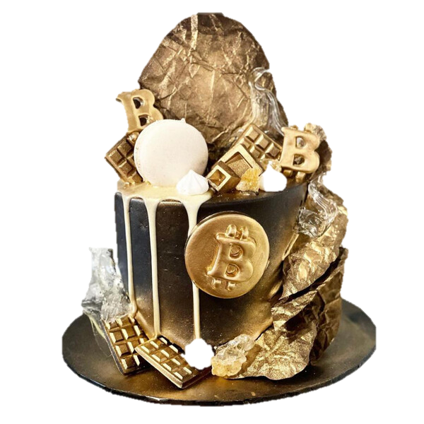
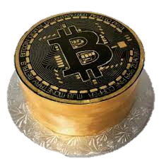
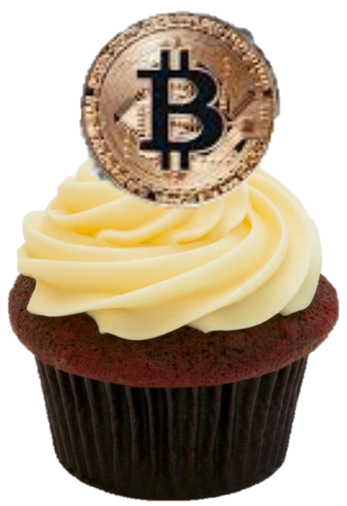
Cake experience roadmap
Wedding Cake
Trading bot that trades all cryptocurrencies
Connects to all trading platforms
Extremely sophisticated trading logic based on Machine Learning
Fully functional GUI (Flask/AWS)
Birthday Cake
Trading bot that connects to multiple trading platforms
Trading logic incorporates several technical indicators: RSI, VWAP, Tweet analysis
GUI (Tkinter)
Cupcake
Trading bot that connects to Binance trading platform
Can trade Bitcoin only
Executes trades based on Bollinger Bands analysis

Slide 9
Bg-9000’s method
Generates Trade Signals from Bollinger Band Analysis
Pulls live Bitcoin prices each second from Binance Websocket
Generates Bollinger Bands using TA Lib
Price < lower band = buy (undervalued)
Price > upper band = sell (overvalued)
lower band < Price < upper band = hodl

Slide 10
Bg-9000’s method
Executes trades using Binance API
Upon a buy or sell signal, the bot uses the order functionality within the Binance API to execute a trade.
The executed trade, balances, and profit are then displayed on the GUI for easy tracking.

Slide 11
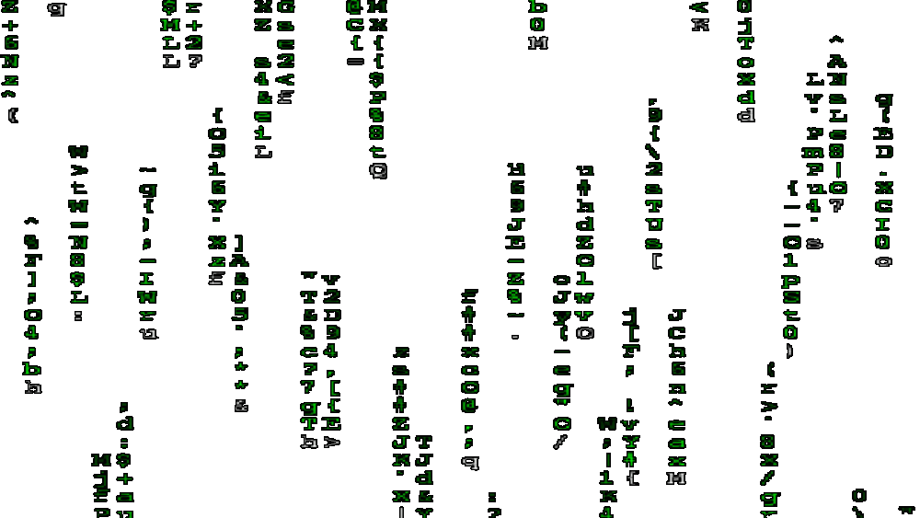
Under the hood
Bg-9000’s code

Slide 12
Developer requirements
Some of the Modules/Libraries used:
websocket
TA-Lib
tkinter
Pandas
Binance - client & enums
threading

Slide 13
Post-mortem
Issues/Limitations Encountered
Limited time and resources
Binace API call limitations – too many calls resulted in lock-out periods
Issues with TA-Lib on ARM64 processor
Used miniforge as ”work around”
Given 2 More Weeks…
Achieve ‘birthday cake design’
Incorporating add’l technical indicators (RSI)
Incorporate sentiment analysis
Add add’l exchanges – Kraken, FTX…

Slide 14
Questions?
Thank you!

